Slide 1
NC College Connect
A Pilot Program to Simplify College Applications for North Carolina Students

Slide 2

Announcing:
NC College Connect
Participating institutions include:
Elizabeth City State University
Fayetteville State University
University of North Carolina Asheville
University of North Carolina at Greensboro
University of North Carolina at Pembroke
Winston-Salem State University
North Carolina community colleges
(all 58 colleges)
  Students will receive a simplified application process at their local community college
NC College Connect is a program created with the goal of increasing access to higher education by simplifying the application process for qualifying North Carolina students to participating UNC System universities and their local North Carolina community college.

Slide 3

This Program is For…
…ALL North Carolina public high school students with a weighted GPA of 2.8 and above.
A student’s eligibility is determined by their GPA at the close of their junior year (academic year 2023-2024).
Just like any college application, a student's hard work is recognized, but it doesn't end here. Students still must maintain their weighted GPA of 2.8 or above throughout their senior year, in addition to graduating from high school and meeting minimum UNC System requirements.

Slide 4
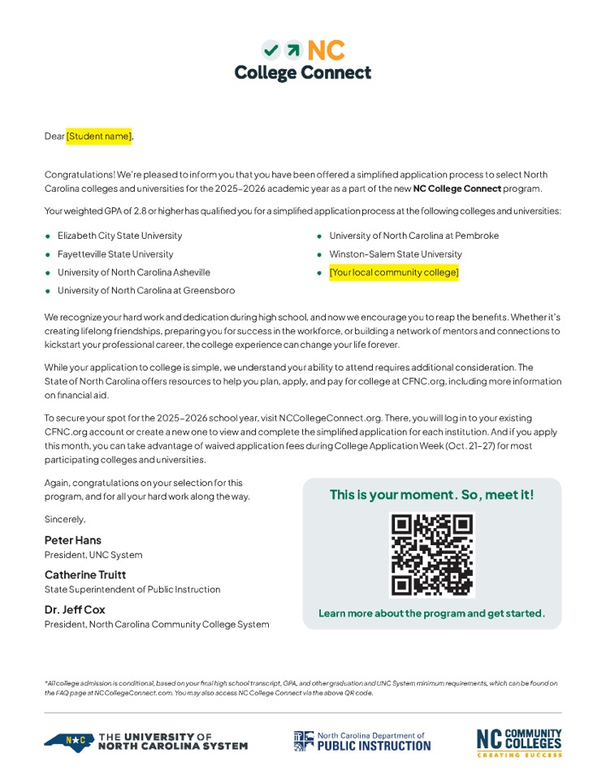

How Will Students Know They’re Eligible?
Eligible students will receive an official letter in the mail in early October. They will also receive a postcard reminder in November.

Slide 5

How Will Students Claim Their Spot?
Students should scan the QR code on their letter to visit NCCollegeConnect.org, where they can access the application portal.

Slide 6

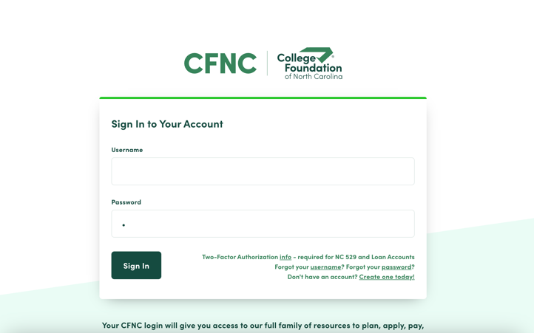
How Will Students Claim Their Spot?
On NCCollegeConnect.org, qualifying students will be directed to log into the NC College Connect portal using their existing CFNC.org account information, or they will be prompted to create a new CFNC account.​

Slide 7

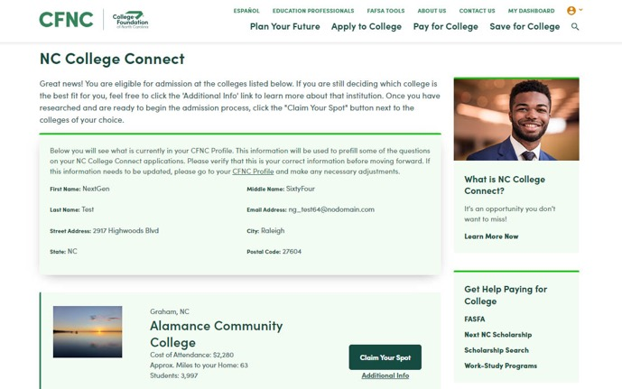
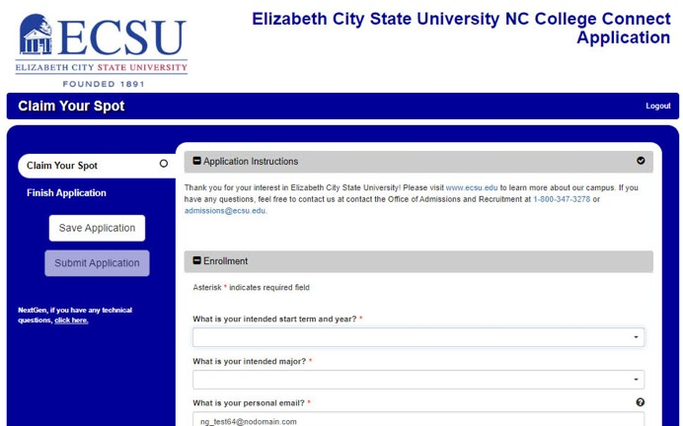
How Will Students Claim Their Spot?
After logging in, students will see a complete list of institutions where they can claim their spot by completing a simplified application for each college or university.​

Slide 8

Will There Be Application Fees?
Students will pay application fees for each college or university, ranging from $30–$75, depending on the institution.
Applications to North Carolina community colleges are free, and all participating institutions will accept approved fee waivers (such as the College Board or ACT fee waiver).
During College Application Week (Oct. 21–27)
most application fees will be waived
—so submit applications this October!

Slide 9

What’s Next?
Students will be contacted by the colleges and universities where they submitted a simplified application with any additional steps required or information needed.

Slide 10
Keep in Mind
Remember - during College Application Week (Oct. 21–27) most application fees will be waived. Make sure students submit their applications this October!
1
2
Should students lose their letter, high schools will have a list of eligible students.
Students are encouraged to explore their financial aid options on CFNC.org, including the Next NC Scholarship, local scholarships, and other sources of federal and state aid, to make informed decisions about their future.
3
While students may qualify for a simplified application process for the colleges and universities that are a part of NC College Connect, students are encouraged to apply to any other North Carolina college or university they would like via CFNC.org, including other UNC System universities and North Carolina private colleges and universities based on their priorities and interests.
4

Slide 11






You Have Support
Education partners across the state are aware of the program details and are here to support you as you help students navigate their journey to college.
[Your Local CFNC Outreach Coordinator]
[Your District PIOs]
For High School-related Questions: NCCollegeConnect@dpi.nc.gov
For UNC System Questions: nccollegeconnect@northcarolina.edu
For NCCCS Questions: nccollegeconnect@nccommunitycolleges.edu

Slide 12


Learn
More!

